Slide 1
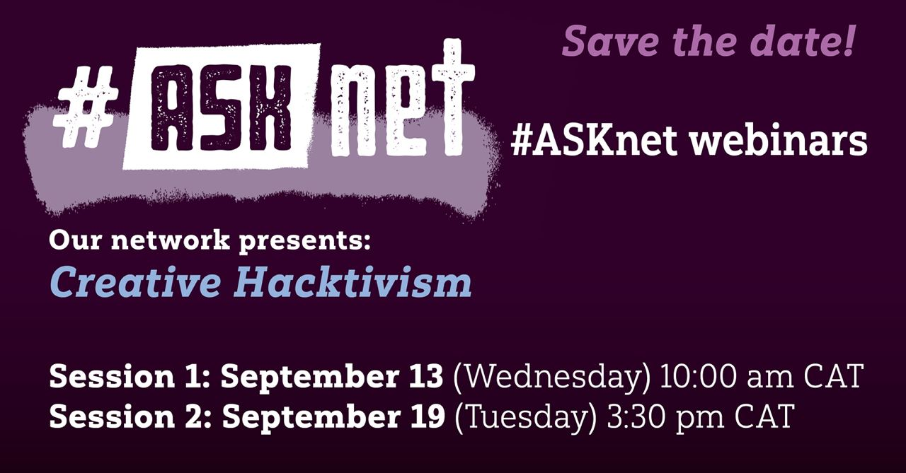


Ask Net & Disruption Network Lab
Wednesday 13th, 10AM - 12AM CAT / 11AM - 1PM EAT
10.15 AM - 11.00 AM CAT → Introduction to Creative Hacktivism
11.00 - 11.05 CAT → break
11.05 - 11.40 → Brian Bamanya AKA Afrorack Presentation
11.40 - 12.00 → Q&A With Afrorack

Slide 2
Objectives of the webinar
Learn about forms and goals of Digital Activism and Hacking to inspire you to take actions in your online and offline community
Raise awareness of the hidden side of the technology we daily use, and identify tools for growing our literacy when we navigate media and the internet in general
Learn about creative forms of peaceful protests that can invigorate your communities and generate collaboration
Learn about resources that can help validate information and investigate topics

Slide 3
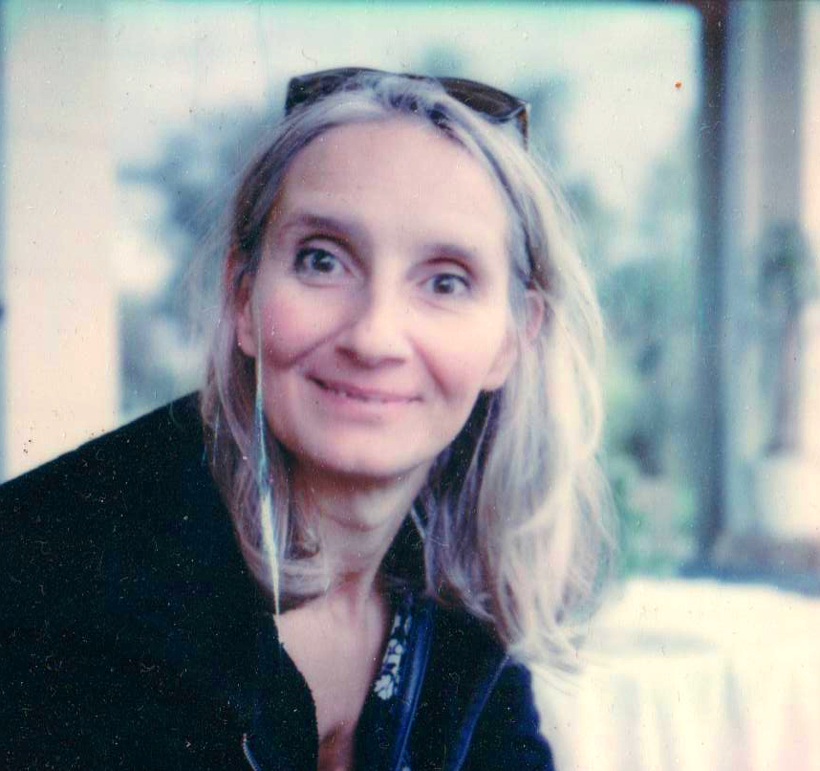
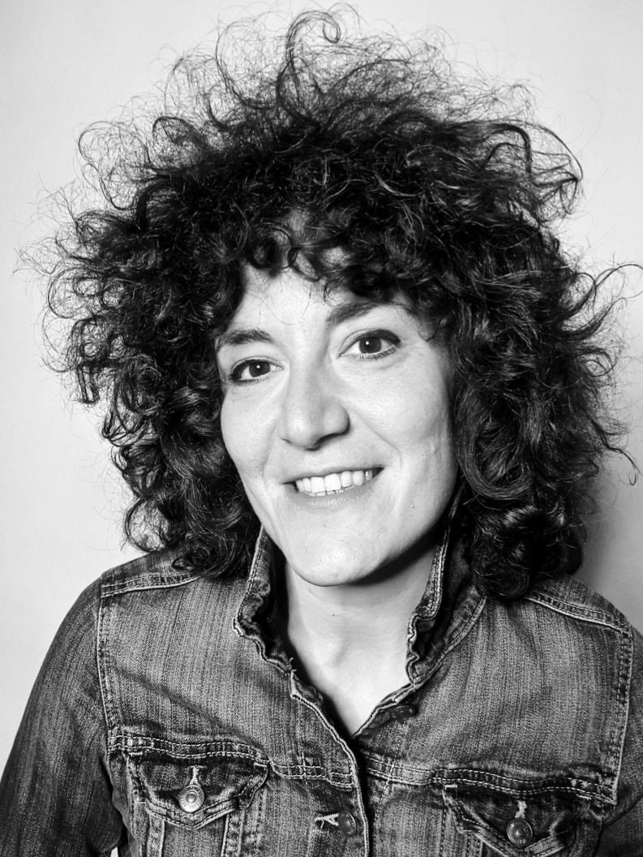
Facilitators
Agnese Trocchi
Social Media Manager at Disruption Network Lab
Sabina Barcucci
Community Manager at Disruption Network Lab
https://www.disruptionlab.org/

Slide 4
How do we work today ❤️❤️❤️
Show your name & Organisations
Feel safe, Participate, ask your question
Use the chat
👋
😍
👍

Slide 5
WARM UP
WHEN YOU THINK OF
AN ACTIVIST
WHO OR WHAT COMES TO MIND?
Give a try with Mentimeter!
Find the link in the chat

Slide 6
CREATOR
/ ARTISTS
HACKER
MIX TECH & ART
FOR A CRITICISING how we USE TECHNOLOGY
ACTIVIST
THE CREATIVE
HAckTIVIST
Challenge norms, provoke change in society and raise awareness
Explore ethical dilemmas within the digital realm

Slide 7
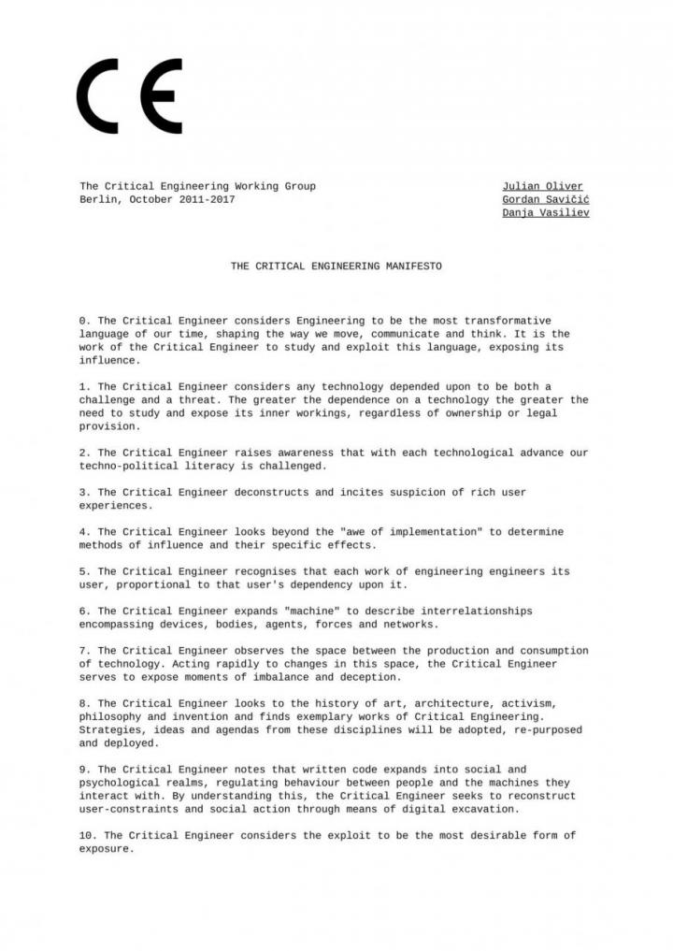
THE CRITICAL ENGINEERING MANIFESTO
»When a machine runs efficiently, when the technology responds to the need we have when we use it, one need focus only on its inputs and outputs and not on its internal complexity. Thus, paradoxically, the more science and technology succeed, the more opaque and obscure they become.«
Bruno Latour

Slide 8
WHY DO WE NEED
A CRITICAL APPROACH
TO TECHNOLOGY?
Give a try with Mentimeter!
Find a new link in the chat

Slide 9
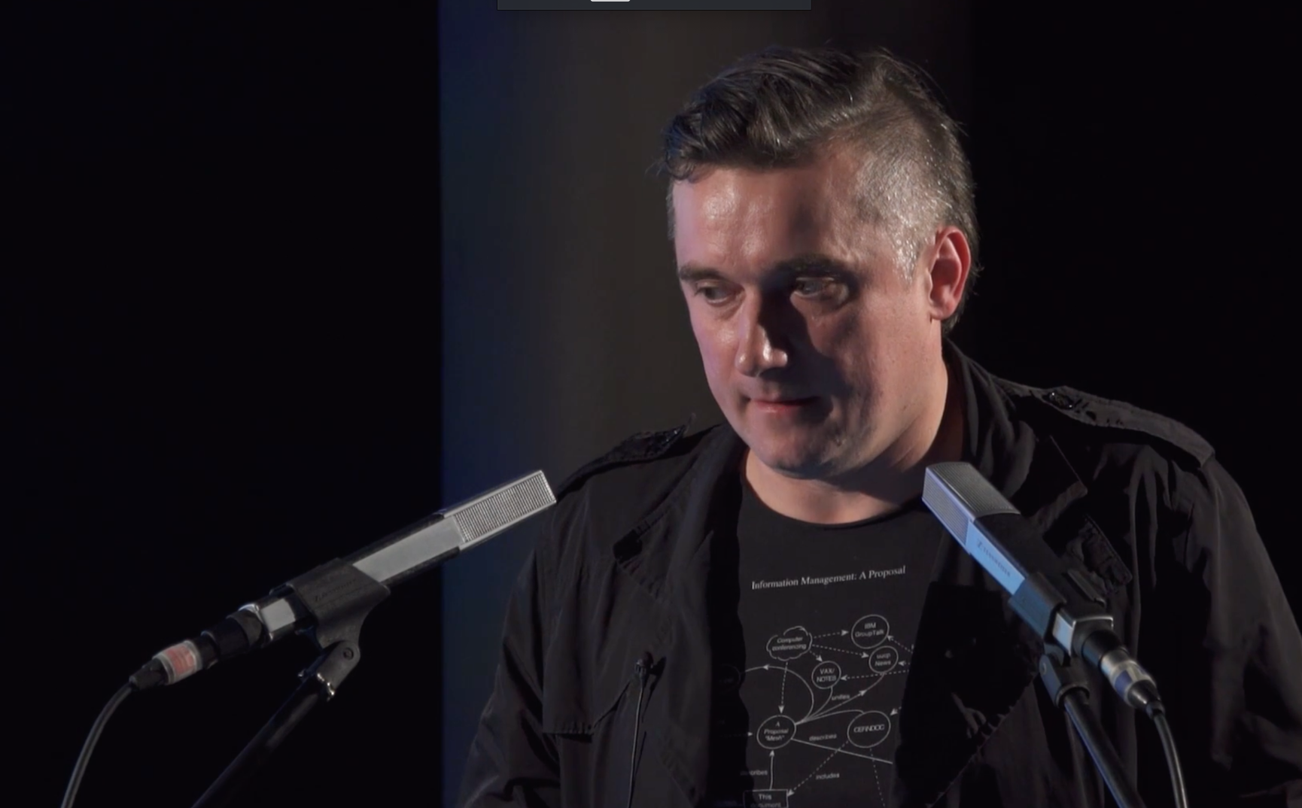
INTERNET & PRIVACY
Hacking can be ethical
»The term Hacker has acquired a very negative sub meaning in the last decades, while it actually describes only a researcher, having a deep interaction with a computer in order to extract as much as possible from it.«
Danja Vasilev
»..when a person gives self-control over to a computer and accepts the default options without question, that person becomes a Cyborg...«
Andrew Yeaman, 1994
https://danjavasiliev.net/
https://aksioma.org/critical.engineering → Dark Internet Topologies video

Slide 10
HOW CAN SYSTEMS OF EXPLOITATION HIDDEN INSIDE TECHNOLOGIES
BE EXPOSED?

Slide 11
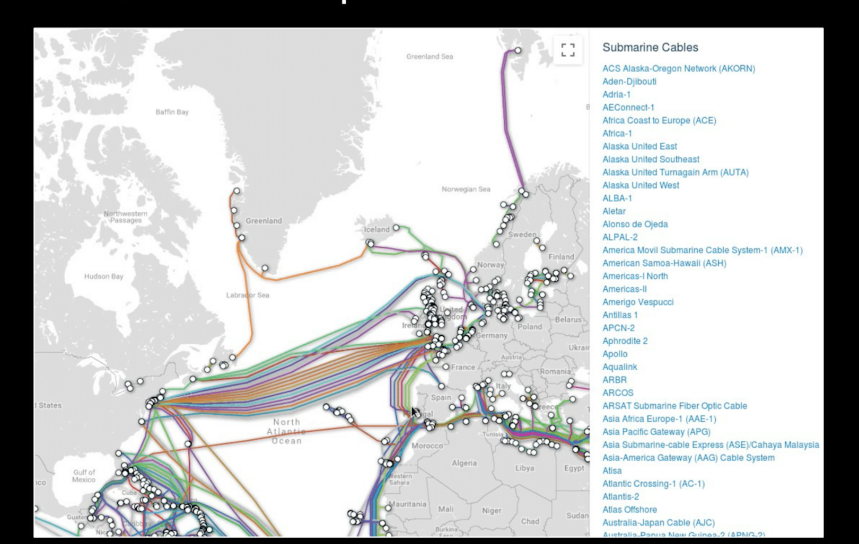
INTERNET & PRIVACY
Who owns the internet?
2022, Danja Vasilev
EXPOSING THE INVISIBLE
https://danjavasiliev.net/
https://aksioma.org/critical.engineering → Dark Internet Topologies video

Slide 12

AI-BASED CONSUMER TECHNOLOGY
ALEXA - A black box
Since 2014, from Amazon Technologies

Slide 13
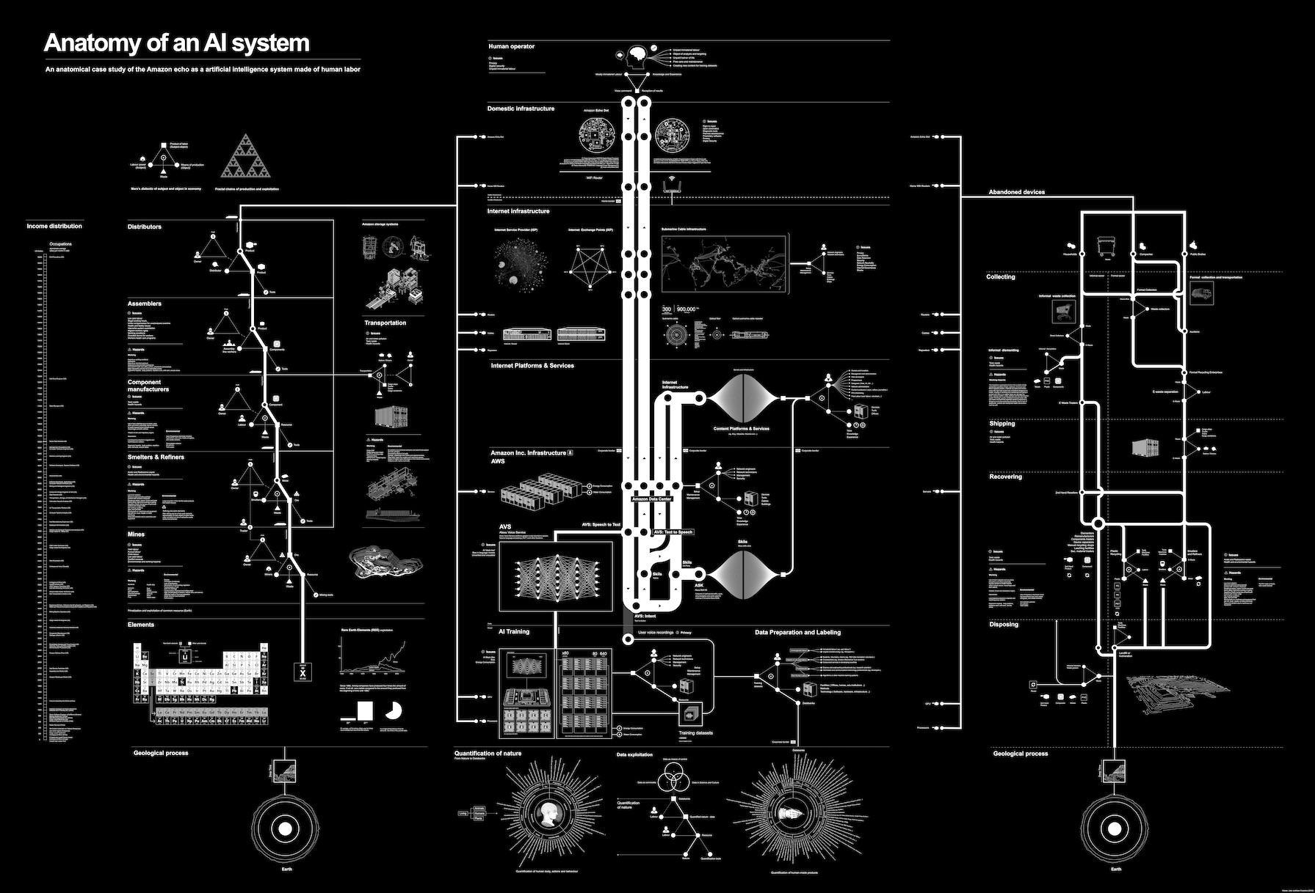
INTERNET & PRIVACY
Anatomy of an AI System
2018, Kate Crawford, Vladan Joler
EXPOSING THE INVISIBLE
https://anatomyof.ai/ - Kate Crawford 1 and Vladan Joler, 2018

Slide 14
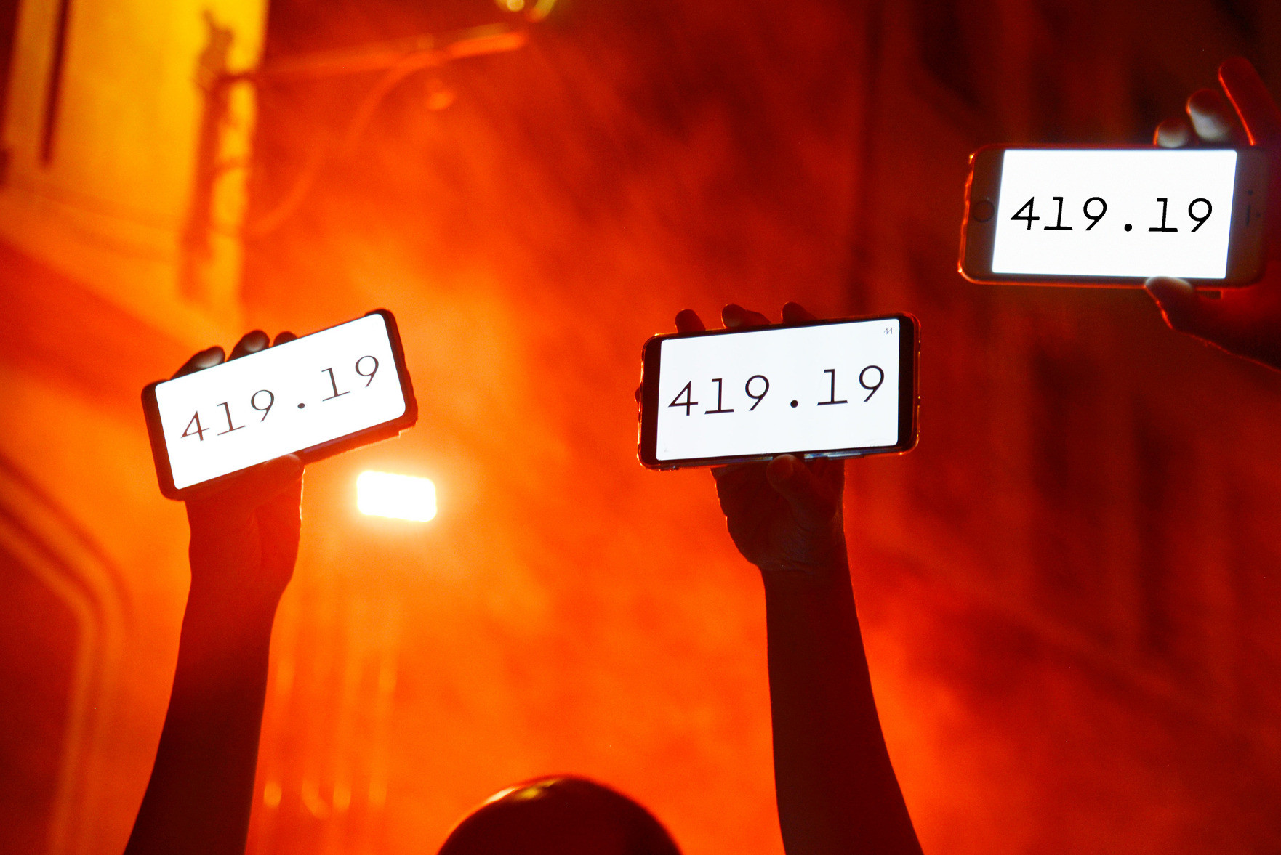
CLIMATE ACTION
Per Million
2022, Julian Oliver, Gordan Savičić
EXPOSING THE INVISIBLE
https://permillion.live/#keeling

Slide 15
HOW CAN WE PROTEST?

Slide 16
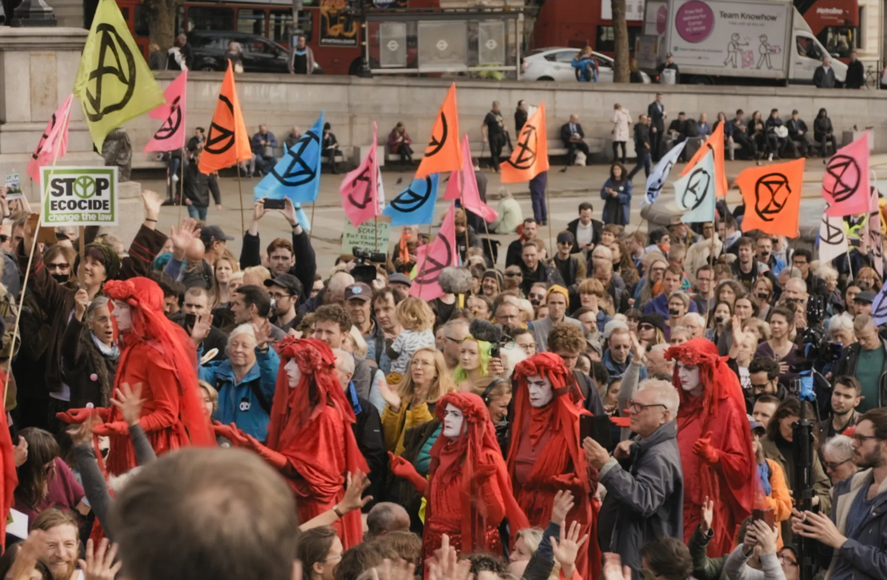
XR - Extinction rebellion
2018 - ongoing, UK - Global
ONLINE & OFFLINE MOBILISATION
https://rebellion.global/

Slide 17
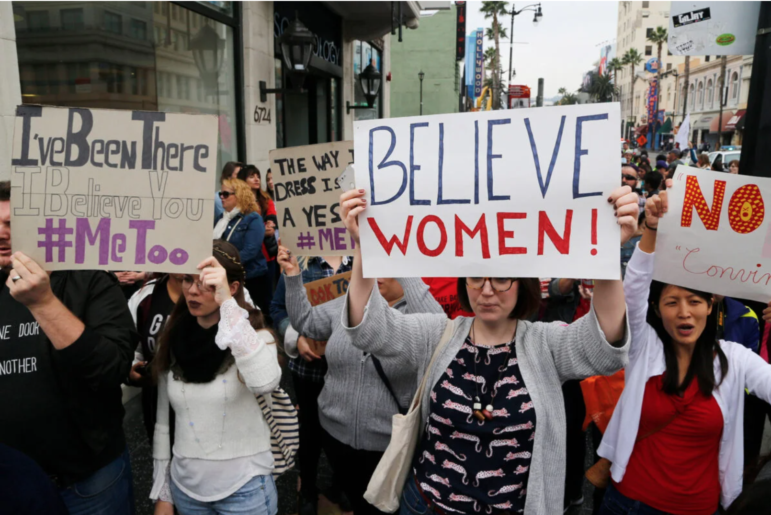
#Metoo Movement
2006- ongoing, US - global
ONLINE & OFFLINE MOBILISATION
https://metoomvmt.org/

Slide 18
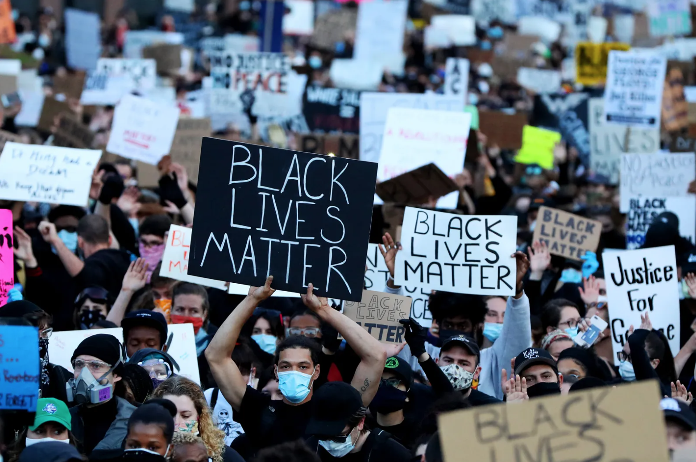
Black Lives Matter
2013- ongoing, US - Global
ONLINE & OFFLINE MOBILISATION
https://blacklivesmatter.com/

Slide 19
WEBSITE DEFACEMENT,
SUBVERTISING
& PRANKS

Slide 20
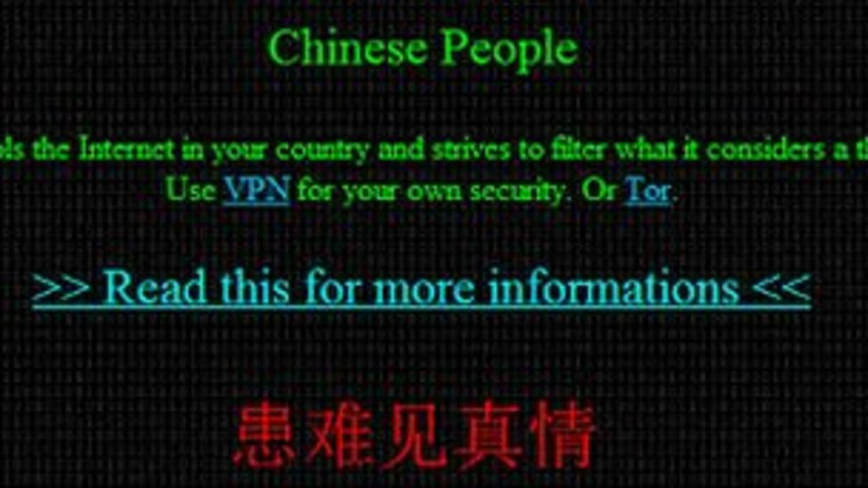
CYBER ATTACK
Anonymous
2012, Chinese websites 'defaced in Anonymous attack'
WEBSITE DEFACEMENT
Website Defacement (WIKIPEDIA)
https://www.bbc.com/news/technology-17623939

Slide 21
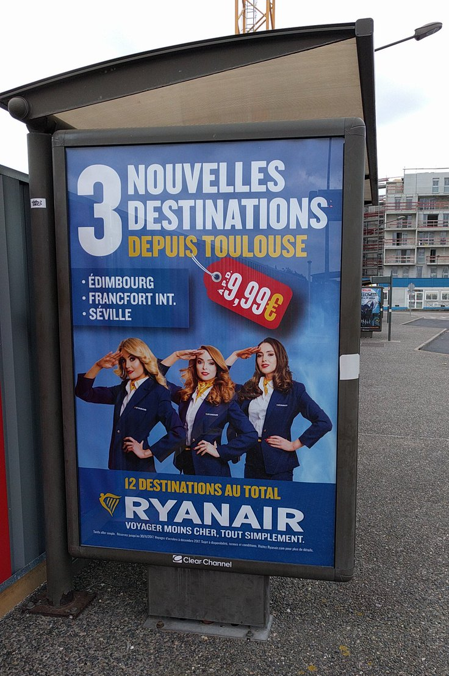
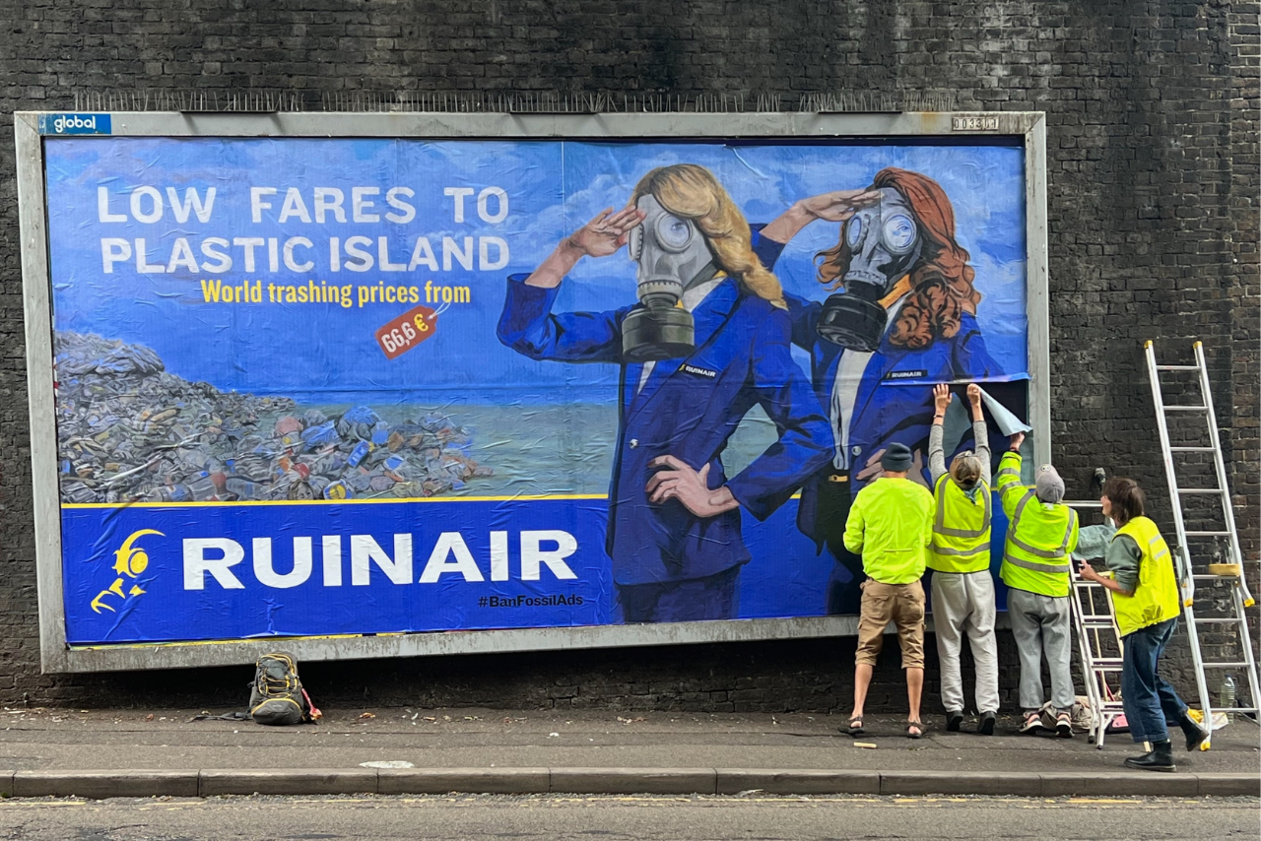
CLIMATE ACTION
RUINAIR - Subvertising
2022, Brandalism, Amsterdam, NL
SUBVERISTING
http://brandalism.ch/projects/airlines-airports/

Slide 22
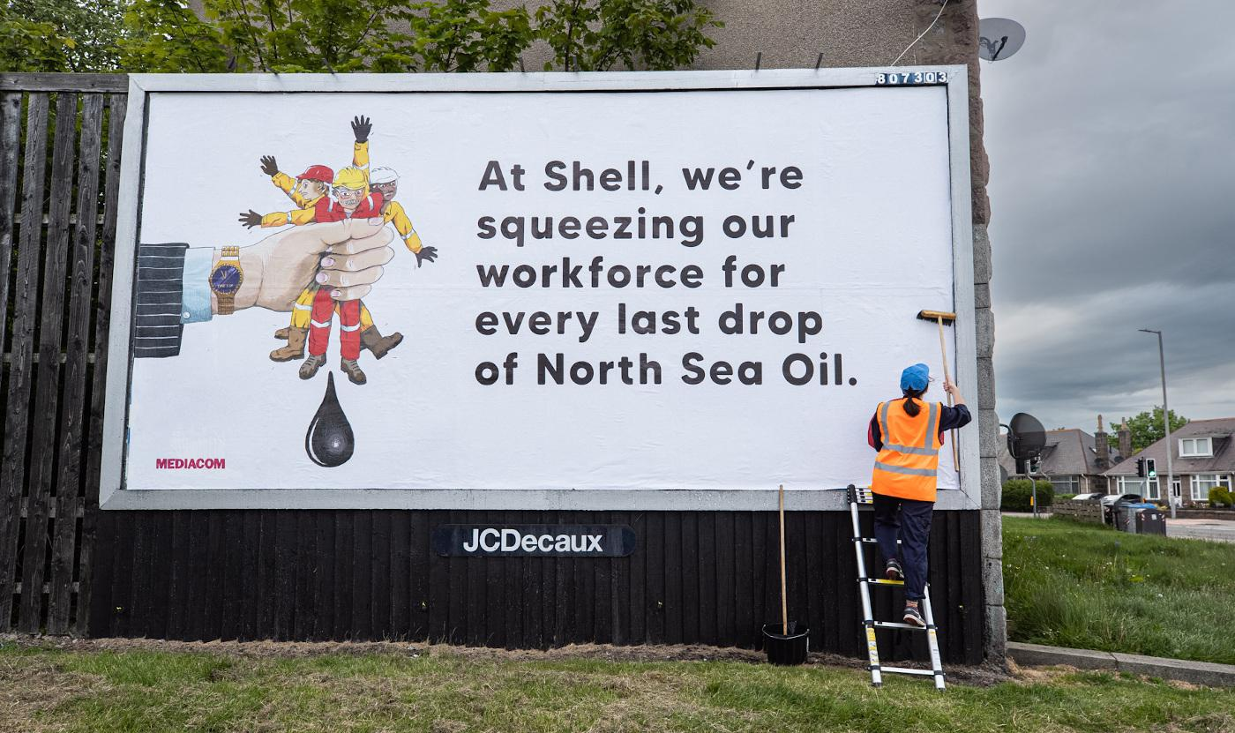
CLIMATE ACTION
JUST TRANSITION - Subvertising
2022, Lindsay Grime, Brandalism (UK)
SUBVERISTING
https://www.campaignlive.co.uk/article/brandalism-hijacks-billboards-criticise-airline-ads-climate-protest/1799628
https://stealthisposter.org/poster/6265a8a4482c360040787c4b

Slide 23
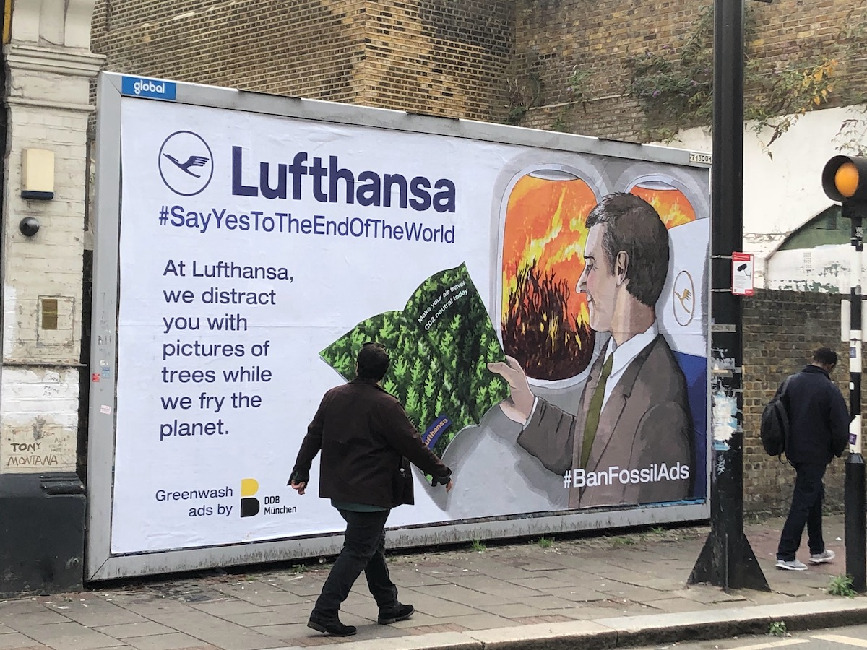
CLIMATE ACTION
JUST TRANSITION - Subvertising
2022, Lindsay Grime, Brandalism (UK)
SUBVERISTING
http://brandalism.ch/projects/airlines-airports/

Slide 24
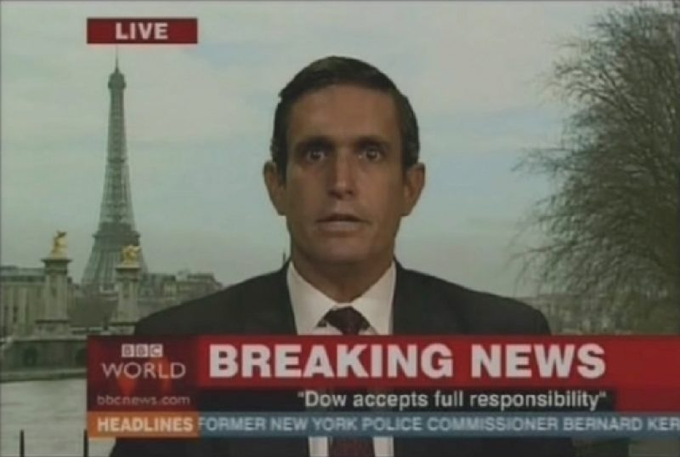
CLIMATE ACTION
THE YES MEN
2004, Bhopal Hoax, on BBC World Service
PRANKS
https://www.youtube.com/watch?v=LiWlvBro9eI

Slide 25
MEDIA AND INVESTIGATIONS
LITERACY

Slide 26
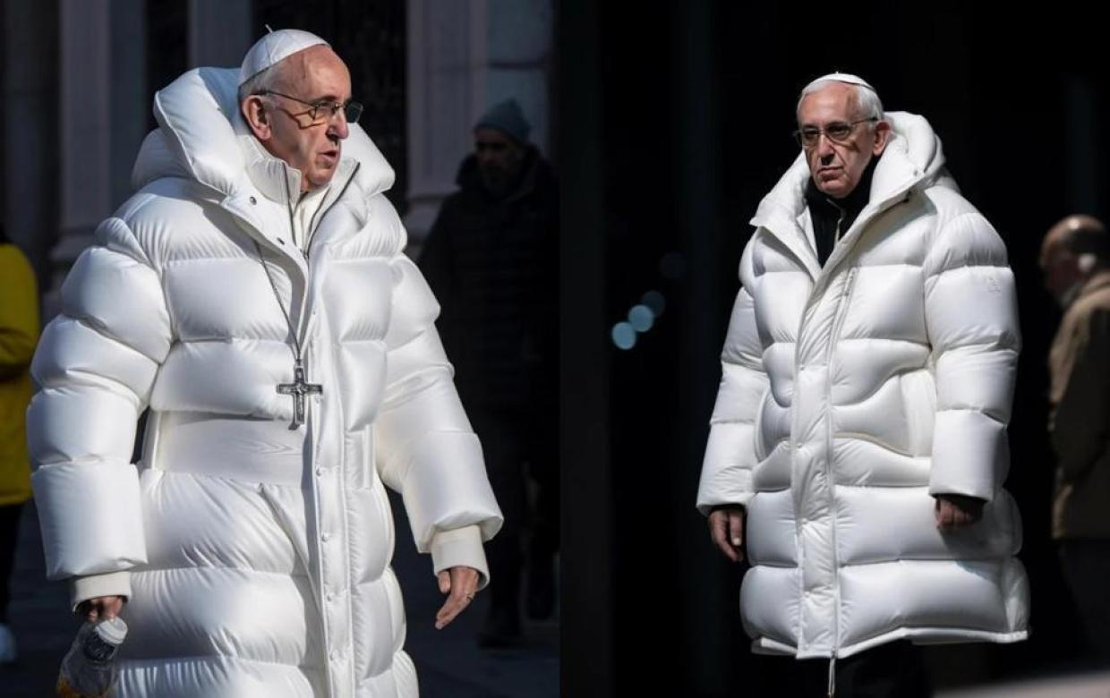
MEDIA LITERACY AND DEEP FAKE
AI-generated fake of Pope Francis in a puffer jacket
2023, found on Reddit
https://en.wikipedia.org/wiki/Midjourney

Slide 27
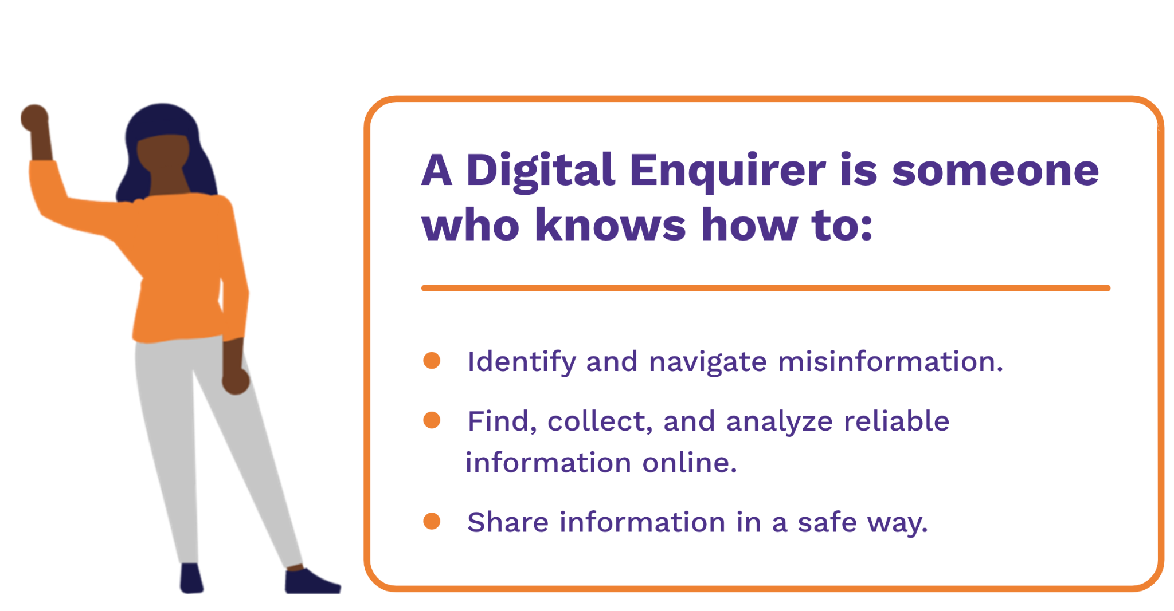
MEDIA LITERACY
Digital Enquirer Kit
2020, Tactical Tech (Berlin)
RETHINKING
https://digitalenquirer.org/

Slide 28
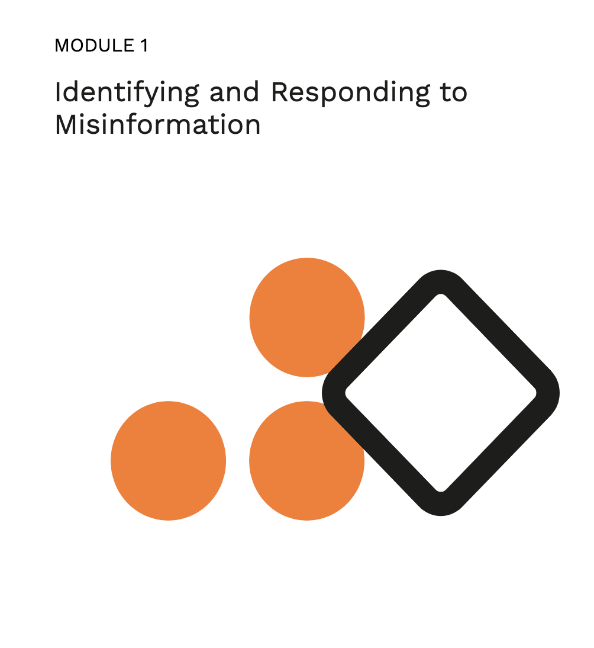
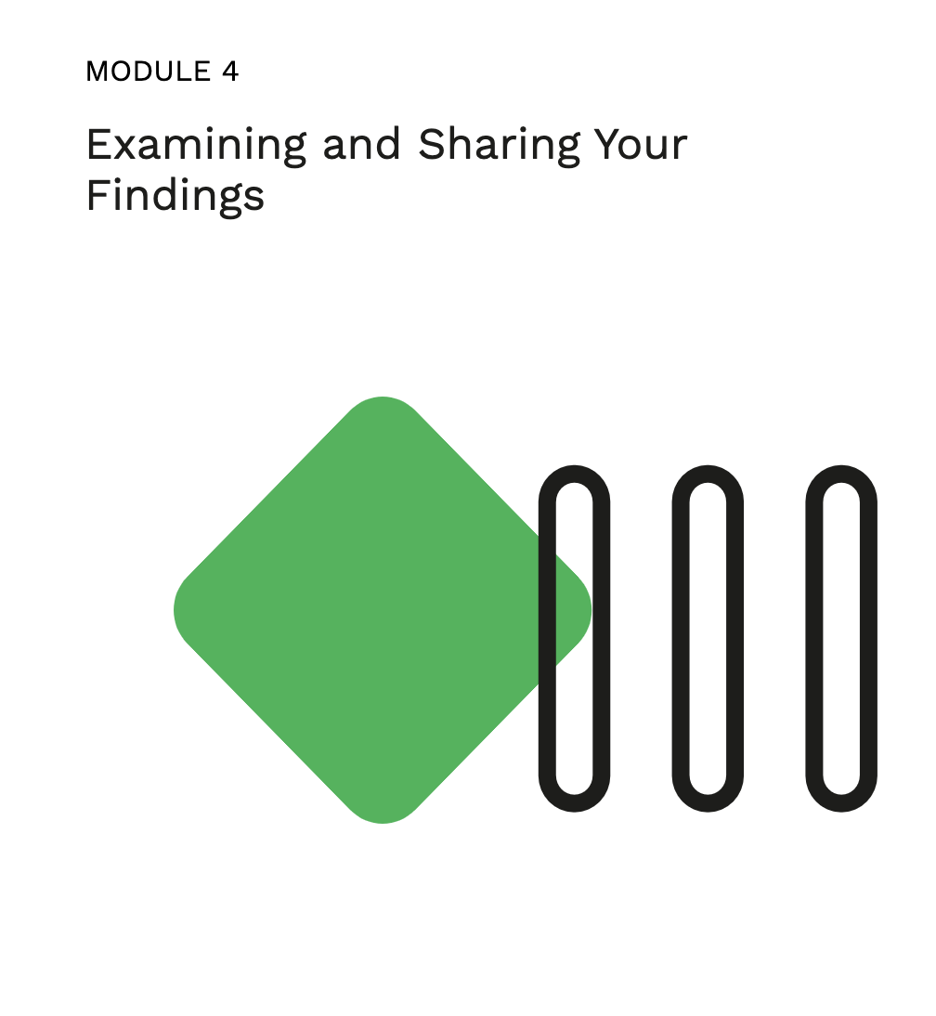


MEDIA LITERACY
Digital Enquirer Kit
2020, Tactical Tech (Berlin)
RETHINKING
https://digitalenquirer.org/

Slide 29
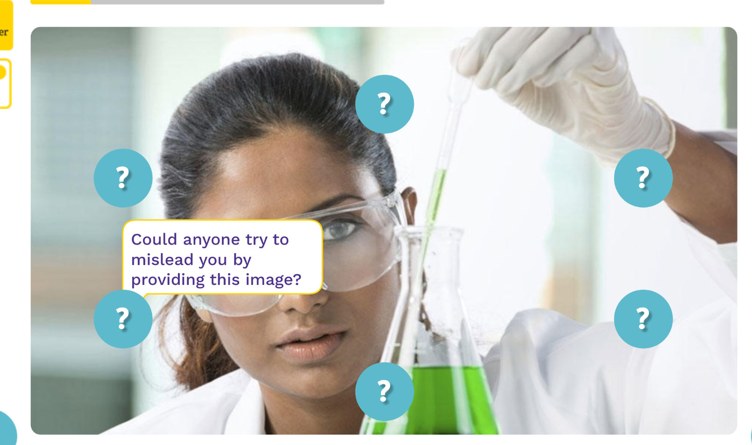
MEDIA LITERACY
Digital Enquirer Kit
2020, Tactical Tech (Berlin)
RETHINKING
https://digitalenquirer.org/

Slide 30
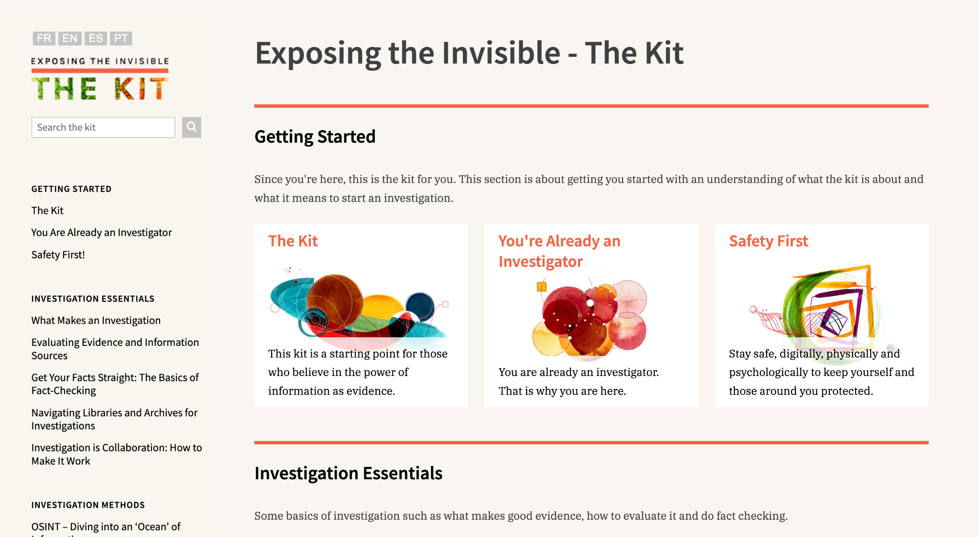
Exposing the invisible Kit
2020, Tactical Tech (Berlin)
RETHINKING
https://kit.exposingtheinvisible.org/en/

Slide 31
WHAT DO YOU NEED MOST TO START YOUR FIRST CREATIVE HACKTIVISM PROJECT?

